Slide 1
From ServiceDesk to AMS-IX NOC
The road to becoming a network engineer

Slide 2
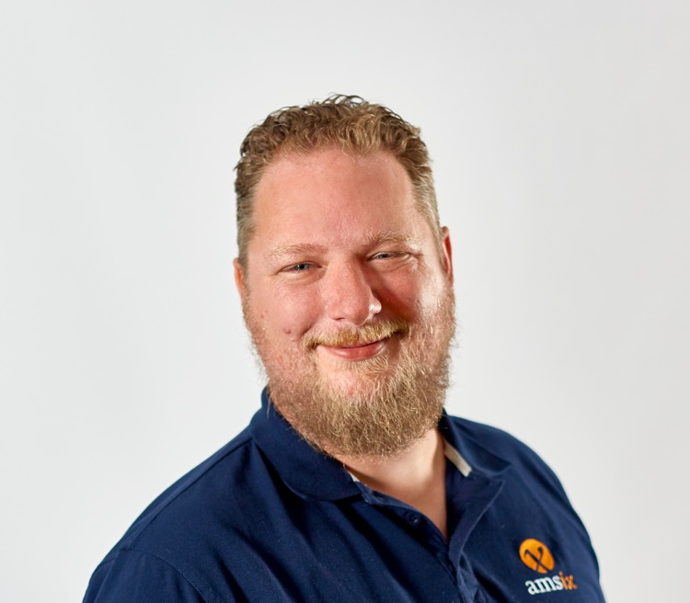
Leroy de Vos
Network Engineer at AMS-IX
https://www.linkedin.com/in/leroy-de-vos/

Slide 3

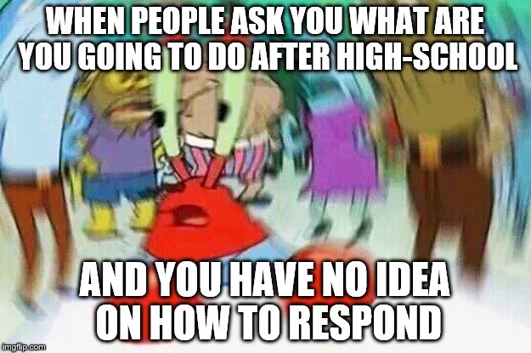
Finished High School, where to go from here?

Slide 4
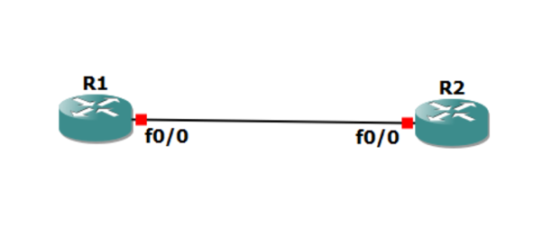
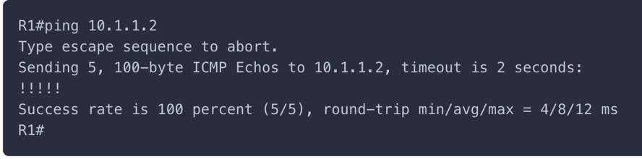
Introduction to network engineering

Slide 5
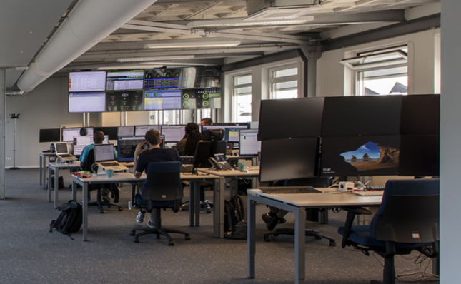

Not all NOCs are the same
Quanza NOC, the more technical one
First introduction to AMS-IX as 1st line support
First time working in shifts
First firmware upgrade
First senior role in a team

Slide 6
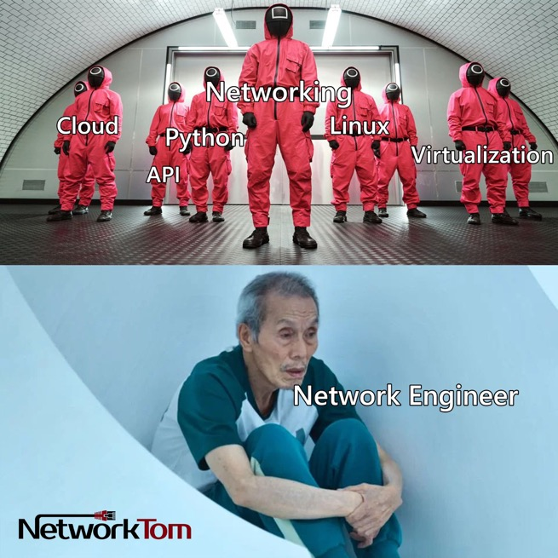
Am I a network engineer now?

Slide 7
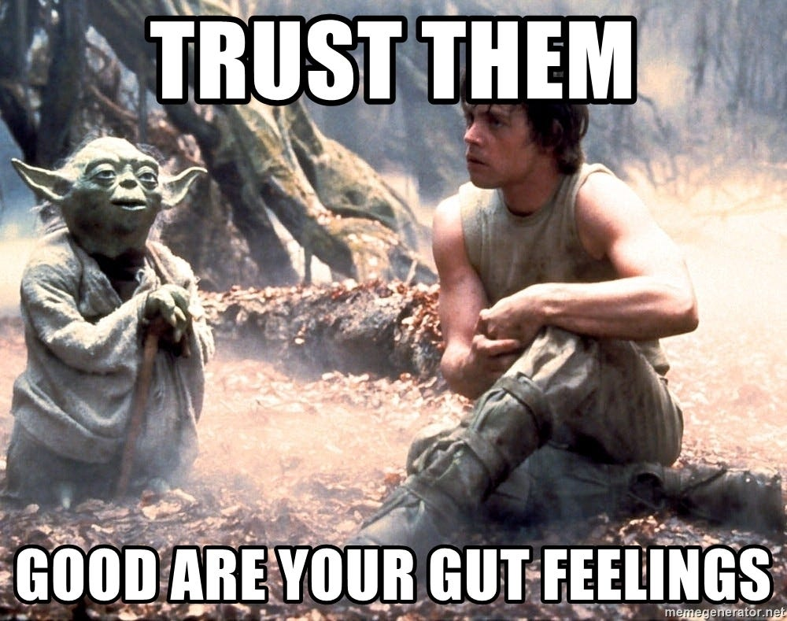
No shame in taking a step back or sideways if it feels right

Slide 8

Hired at AMS-IX

Slide 9
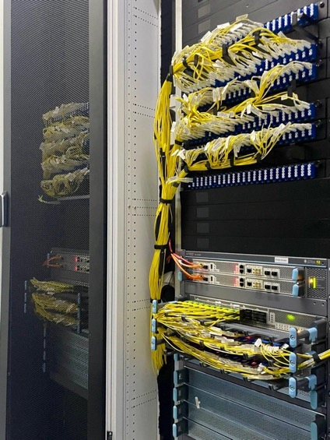
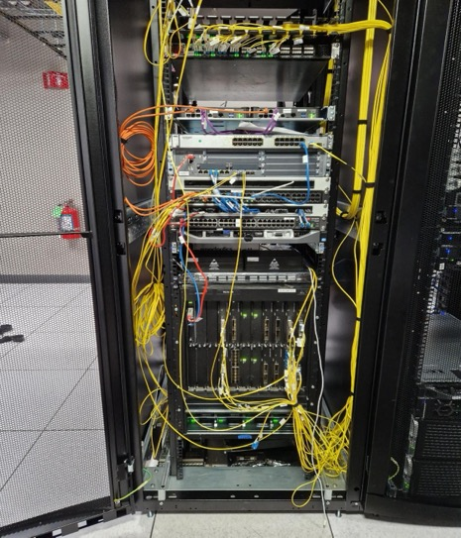
Projects I’ve been working on
Chicago, first remote project
Replacing and upgrading our Smartoptic devices on site
Yes, I know better now

Slide 10
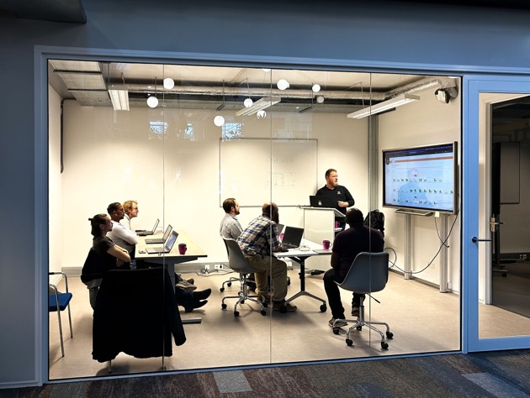
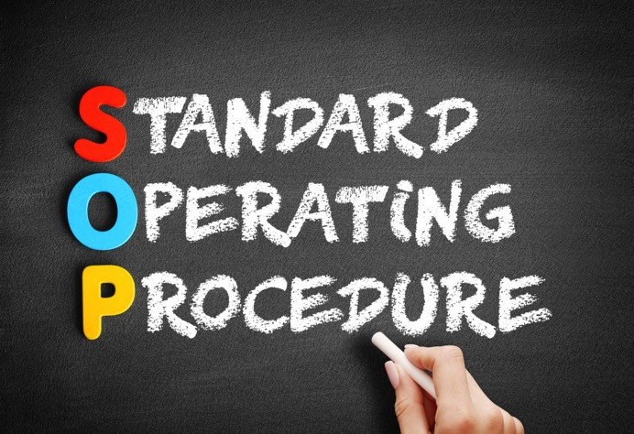
Supporting our 1st line support at Quanza
Teaching AMS-IX at my previous job
Expanding our 1st line SOPs

Slide 11
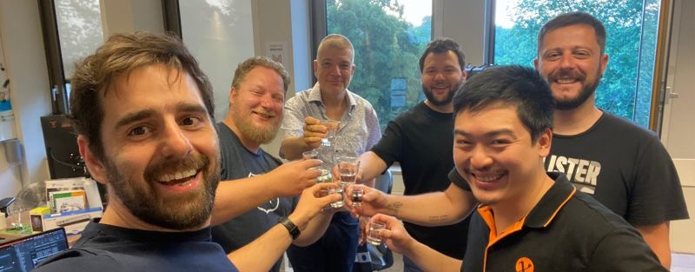
Part of the very first Juniper migration
A happy team the morning when the migration was finally done

Slide 12
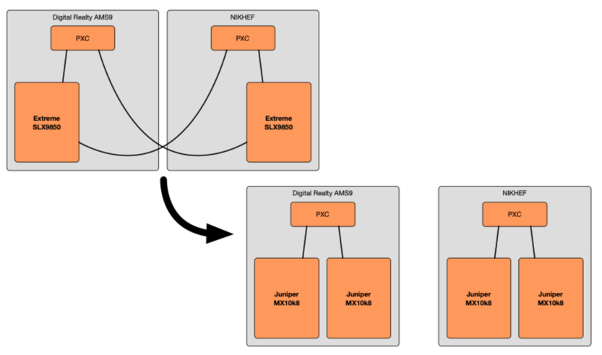
“The Monster Project”, splitting up Nikhef and Digital Realty AMS9 (Former SARA).
https://www.ams-ix.net/ams/stories/30-years-and-a-broken-marriage

Slide 13
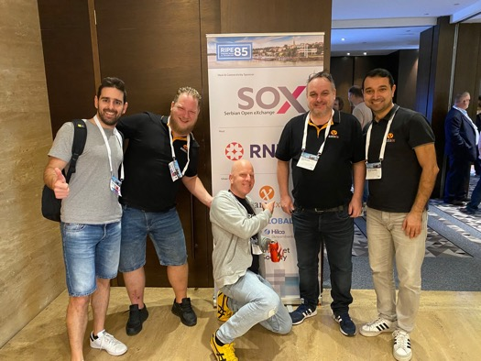
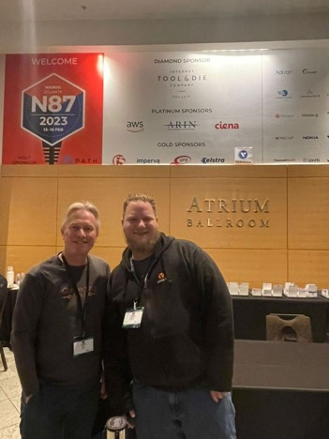
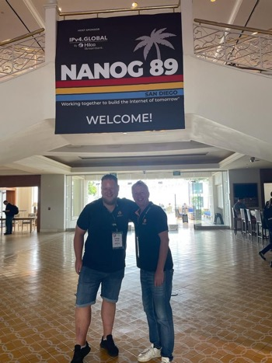
Going to network events
RIPE85
NANOG87
NANOG89

Slide 14
So, what went wrong
The life of a network engineer is not all roses and sunshine

Slide 15
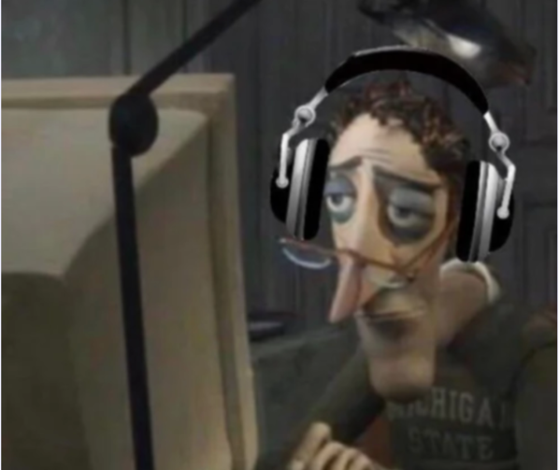
My first outage during a on-call shift
My first real incident was at our remote location in Chicago where we experienced an issue with
The connection we have between the DRT DC floor and Equinix floor.

Slide 16
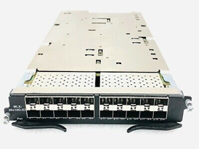
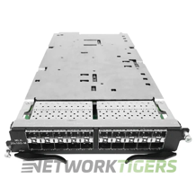

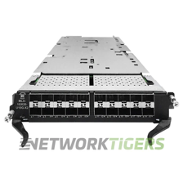
Especially at night double check what you need to replace
BR-MLX-10Gx20-M
BR-MLX-10Gx20-X2
BR-MLX-1GX20-U10G-X2

Slide 17
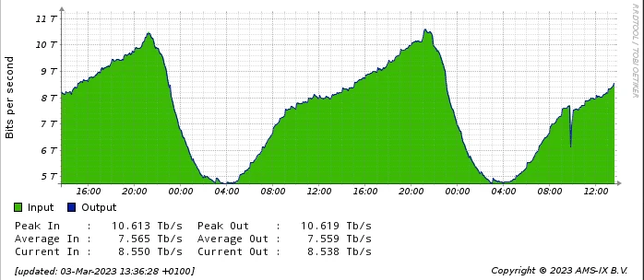
Nightmare, causing a loop on the AMS-IX platform
This was me

Slide 18
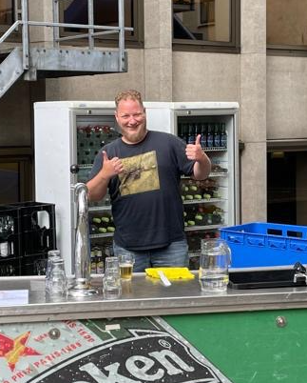


So, am I a network engineer now?

Slide 19
Questions ?

Slide 20

Thank you

